Slide 1
Information Architecture

Slide 2
Common mistakes in web design
http://www.nngroup.com/articles/top-10-mistakes-web-design/

Slide 3
What is Information Architecture?
organizing, structuring, and labeling content in an effective and sustainable way
science of organizing and structuring content of the websites, web and mobile applications, and social media software.
The goal is to help users find information and complete tasks. To do this, you need to understand how the pieces fit together to create the larger picture, how items relate to each other within the system.

Slide 4
Understanding Information Architecture
https://prezi.com/aafmvya6bk7t/understanding-information-architecture/

Slide 5
Statistics
(Source: Semantic Studios)
Employees spend 35% of productive time searching for information online.
Working Council for Chief Information Officers
Basic Principles of Information Architecture
The Fortune 1000 stands to waste at least $2.5 billion per year due to an inability to locate and retrieve information.
IDC, The High Cost of Not Finding Information
Forfeited revenue: poorly architected retailing sites are underselling by as much as 50%.
Forrester Research, Why Most Web Sites Fail

Slide 6
Why is Information Architecture Important?
(Source – Semantic Studios)
Cost of finding (time, frustration)
Cost of not finding (bad decisions, alternate channels)
Cost of construction (staff, technology, planning, bugs)
Cost of maintenance (content management, redesigns)
Cost of training (employees, turnover)
Value of education (related products, projects, people)
Value of brand (identity, reputation, trust)

Slide 7
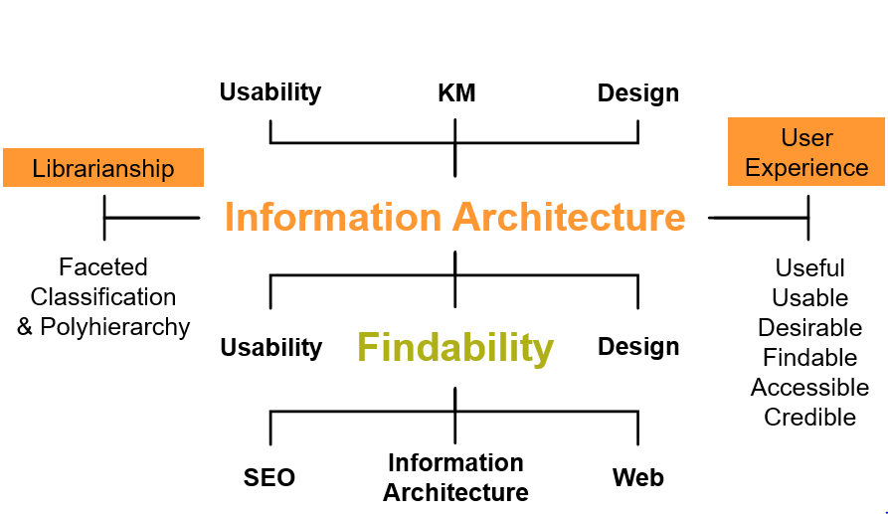
Information Architecture(at the center)

Slide 8
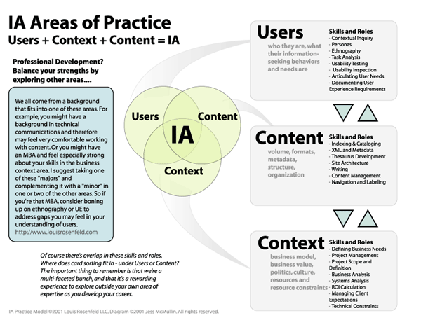
Things to thought of before designing IA

Slide 9
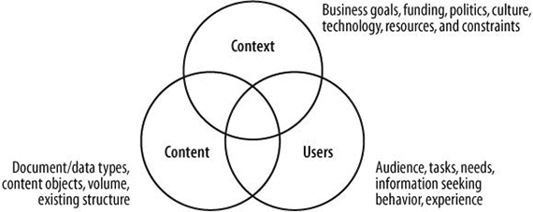
Context Users and Content

Slide 10
Designing IA System Components
Organization Systems
Labeling Systems
Navigation Systems
Searching Systems

Slide 11
Organization Systems
These are the groups or the categories in which the information is divided. Such system helps users to predict where they can find certain information easily. There are three main organizational structures:
1) Hierarchical
2)Sequential
3)Matrix

Slide 12
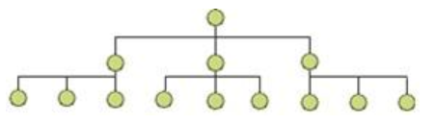
Hierarchical
Its main goal is to present content on the carrier, be it a book page or poster, web page or mobile screen, in such a way that users can understand the level of importance for each element. It activates the ability of the brain to distinguish objects on the basis of their physical differences, such as size, color, contrast, alignment etc.
In Hierarchical Structures, sometimes referred to as tree structures or hub-and-spoke structures, there is a top down approach or parent/child relationships between pieces of information. Users start with broader categories of information (parent) and then drill further down into the structure to find narrower, more detailed information (child).

Slide 13
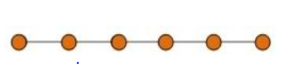
Sequential Organization
Websites with Sequential Structures require users to go step-by-step, following a specific path through content.
An example of this type of structure is when a user is attempting to purchase something or are taking a course online. Sequential structures assume that there is some optimal ordering of content that is associated with greater effectiveness or success

Slide 14
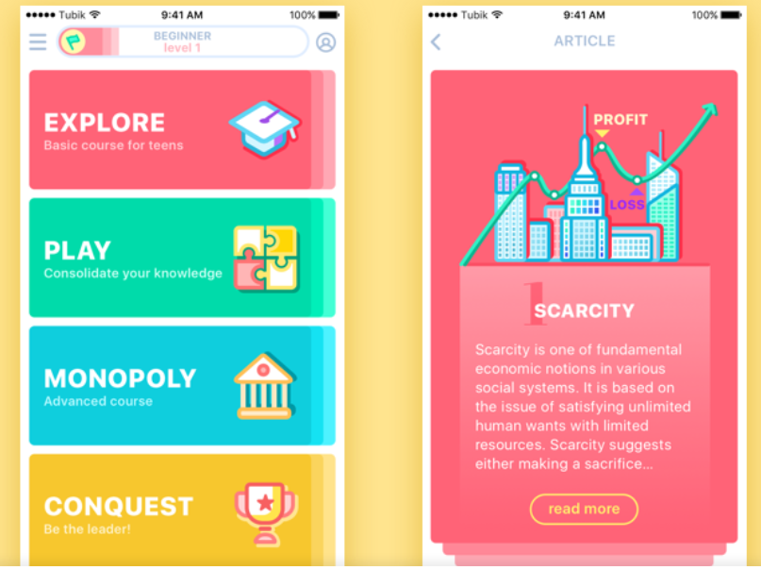
Matrix Structures
A Matrix Structure allows users to determine their own path since content is linked in numerous ways. This type of structure takes full advantage of the principles behind hypertext, or HTML. For example, one user could choose to navigate through a set of content based on date while another navigates based on topic.
Card Sorting Approach can be used for Matrix Structure

Slide 15
Labeling systems
Labeling, or what we call pages and links on a site, ensures that our navigation and hierarchy is appropriately titled, which plays a large role in whether users will be able to find that information.
For example, when the designers give contact information of the company on the website, it usually includes the phone number, email, and social media contacts. However, designers can’t present all of this information on one page. The button “Contact” in the header of the page is a label that triggers the associations in the users’ heads without placing the whole data on the page. So, the labeling system aims at uniting the data effectively.

Slide 16
Navigation System
The navigation system, in terms of IA, involves the ways how users move through content.
It’s important to always remember that IA is all about finding ways to help the user navigate the information in order to reach their goal.
The deliverable that is most commonly associated with this work is a site map, which illustrates the hierarchy of content across a website.

Slide 17
Sitemaps
They show how the navigation should be structured
They help identify where content will sit and what needs to be produced
They help show the relationship between different pages
They provide a structure upon which to begin estimates for development
They are the first tangible deliverable showing what you will be creating

Slide 18
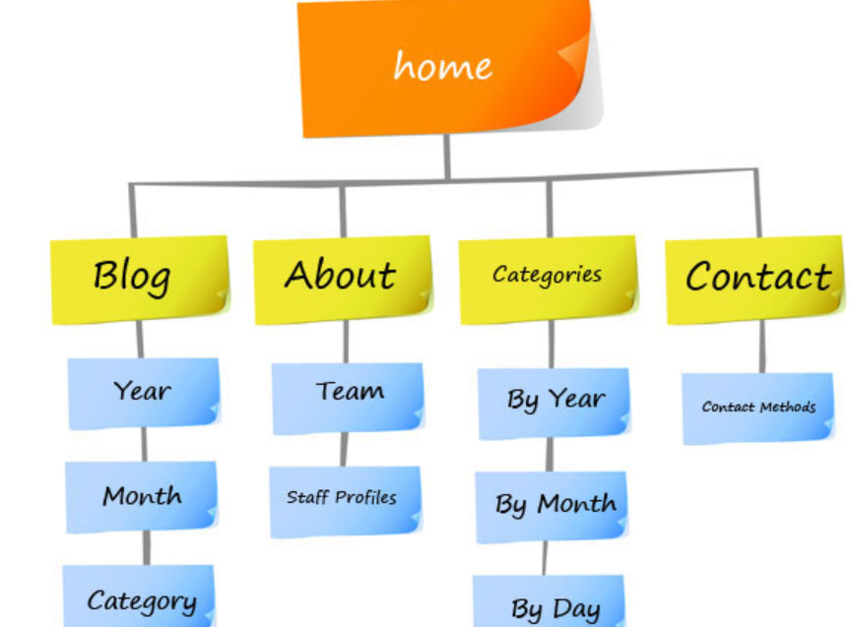
Sitemap Example

Slide 19
Search Systems
This system is used in information architecture to help users search for the data within the digital product like a website or an app. The searching system is effective only for the products with loads of information when the users risk getting lost there. In this case, the designers should consider a search engine, filters, and many other tools helping users find content and plan how the data will look after the search.

Slide 20
Taxonomy and Metadata
Information of Information
For example, a clothing store might consider multiple taxonomies: one based on fabric type, another based on clothing item, and another based on color. The information architect would tag a shirt with cotton, or nylon as well as shirt or top and red. That way, a shopper with the mental model “I need a new shirt” could easily find this red, cotton shirt

Slide 21
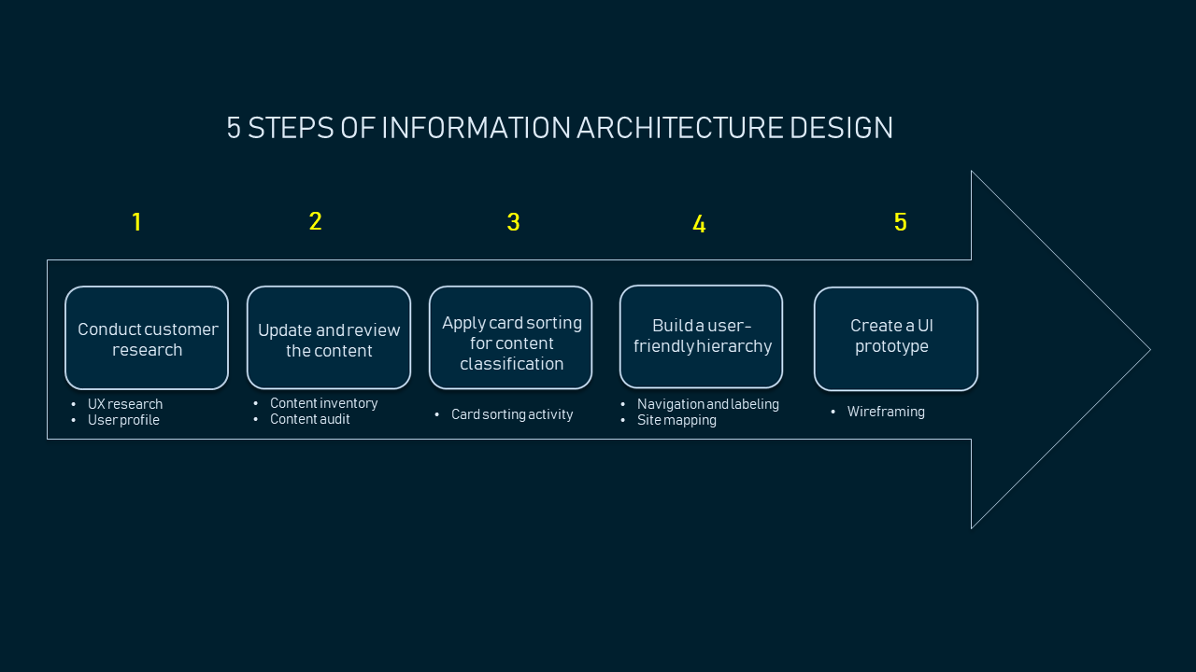
Steps of IA design

Slide 22
Steps:
1. Conduct customer research
2. Update and review the content
3. Apply card sorting for content classification
4. Build a website hierarchy for user-friendly navigation
5. Create a UI prototype for future development

Slide 23
Information Architecture Design Styles
Top down : Top-down architecture starts with a broad overview and understanding of the website’s strategy and goals, and creates a basic structure first. From there, content relationships are refined as the site architecture grows deeper, but it’s all viewed from the overall high-level purpose of the site.
Bottoms up: The bottom-up architecture model looks at the detailed relationships between content first. With this kind of architecture, you might start out with user personas and how those users will be going through the site. From there, you figure out how to tie it all together, rather than looking at how it all relates first.

Slide 24
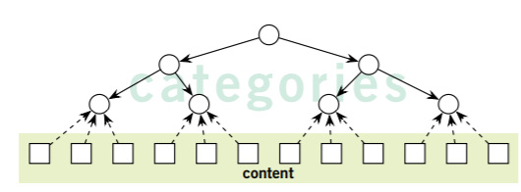
Top Down Approach
Top down :
Take the whole problem and split it into two or more parts.
Find solution to these parts.
If these parts turn out to be too big to be solved as a whole, split them further and find find solutions to those sub-parts.
Merge solutions according to the sub-problem hierarchy thus created after all parts have been successfully solved.

Slide 25
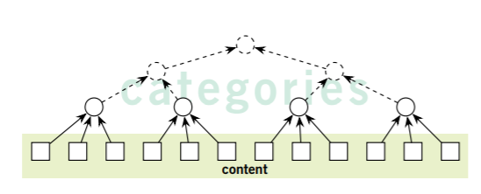
Bottoms Up Approach
Breaking the problem into smallest possible(and practical) parts.
Finding solutions to these small sub-problems.
Merging the solutions you get iteratively(again and again) till you have merged all of them to get the final solution to the "big" problem.

Slide 26
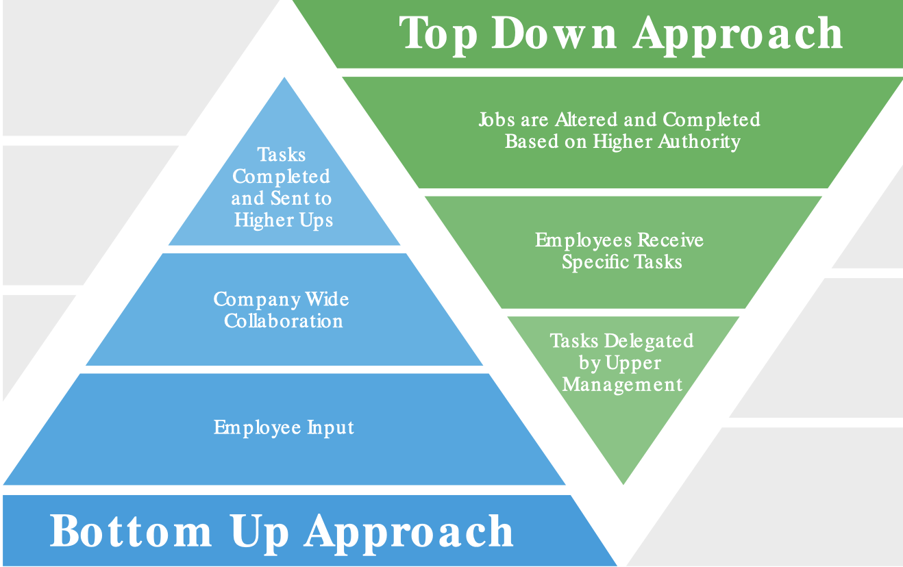
Examples of Top-Down Approach and Bottom Up Approach

Slide 27
Applications of these approaches
The bottom-up approach in banking deals with microeconomic factors, focusing less on market cycles and more on an individual company’s performance in comparison to the larger market.
Investing/Banking
The top-down approach is leveraged when developing molecular manufacturing strategies, whereas the bottom-up approach is ideal for developing conventional manufacturing strategies
Nanotechnology
Sensory input is thought of as a bottom-up approach because someone takes in information from the environment in order to make an informed decision
Neuroscience &
Psychology
The Ecole des Beaux-Arts School of Design beginsthe designs with a basic drawing plan that outlines a project in full, lending itself to a top-down approach.
Architecture

Slide 28
Card Sorting
Card sorting is a method used to help design or evaluate the information architecture of a site. In a card sorting session, participants organize topics into categories that make sense to them and they may also help you label these groups. To conduct a card sort, you can use actual cards, pieces of paper, or one of several online card-sorting software tools.
Open Card Sort: Participants are asked to organize topics from content within your website into groups that make sense to them and then name each group they created in a way that they feel accurately describes the content. Use an open card sort to learn how users group content and the terms or labels they give each category.
Closed Card Sort: Participants are asked to sort topics from content within your website into pre-defined categories. A closed card sort works best when you are working with a pre-defined set of categories, and you want to learn how users sort content items into each category.

Slide 29
Chapter 5 - Structure Plane
What are the 2 things we deal in the structure plane?
What is Interaction Design and why is it important?
What are conceptual models? What conceptual models you might use in your project?
What is Error Handling and the three layers of it? Work as a group for finding the scenarios and practical examples of how each type of error handling should be used for your project.
What are the things to keep in mind while creating the language and metadata for the site?

Slide 30
Class Discussion/Group Assignment – IA Case Study – 30 Min
https://uxdesign.cc/ambiguity-an-information-architecture-case-study-6e2608ac8de1
What are your reflections after reading this case study, and anything you learned or any thoughts for information architecture improvements if any?

Slide 31
Group Assignment - Information Architecture for your project
Create an Information Architecture using open and closed card sorting? Any differences to report between 2 approaches?

Slide 32
Useful resources on IA
  http://iainstitute.org/
  Semantic Studios
  http://semanticstudios.com/
  http://www.jjg.net/ia/

